Slide 1
2021/01/11
fused Environmental model
TDP Proposal as Add-ons for OSAP framework

Slide 2
Content
WHAT IS THE MULTISENSOR FUSION & BACKGROUND?
FUSION ALGORITHM
LATE FUSION
Scenario
Fusion System Design
Notes:
包含的内容有3个方面

Slide 3

WHAT IS THE MULTISENSOR FUSION & BACKGROUND?
WHERE ARE WE?
WHAT’S ON THE WAY?
WHERE ARE WE GOING?
Simultaneous
Location
And
Map
Perception Fusion Base on
Machine
Learning
Notes:
要回答什么是多传感器融合，首先要回答以下2个问题
在哪里，要去哪里？ 路上有什么？
这2个问题也是L3,L4要回答的问题
通过这2个问题 就分别引出了 目前在自动驾驶领域 比较火的 2个技术
建图 与 定位
基于机器学习的感知融合
而这2个技术分别都要用到多传感器融合。
这也就回答了他的背景。
那什么是多传感器融合呢？

Slide 4
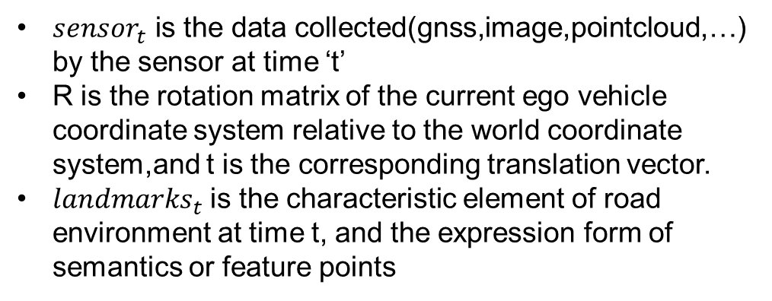
WHAT IS THE MULTISENSOR FUSION & BACKGROUND?
WHERE ARE WE?
$$F\left({sensor}_{t}\right)→ \left\{{\left[\begin{matrix}R & t \\ 0 & 1\end{matrix}\right]}_{t},\left\{{landmarks}_{0}，{landmarks}_{1}…{landmarks}_{t}\right\}\right\}$$
WHERE ARE WE GOING?
${sensor}_{t}$ is the data collected(gnss,image,pointcloud,…) by the sensor at time ‘t’
R is the rotation matrix of the current ego vehicle coordinate system relative to the world coordinate system,and t is the corresponding translation vector.
${landmarks}_{t}$ is the characteristic element of road environment at time t, and the expression form of semantics or feature points
Simultaneous
Location
And
Map
Notes:
在回答这个问题之前
我们先对定位与建图 以及 感知融合 ，分别做一个简单数学建模来分析一下 。
定位 与建图 的数学建模 是
传感器与旋转矩阵和路标的映射关系。
其中多传感器信息包括 ：gps信息，图片信息，激光雷达点云信息，雷达信息等。。 这是输入信息
输出信息是t时刻自车的位姿，以及0到t时刻的路标信息
也就是说对于SLAM来说 多传感器融合是为其提供一个套，时间同步，空间同步的，融合数据，使得SLAM可以计算出当前自车的位姿 以及 地图信息

Slide 5
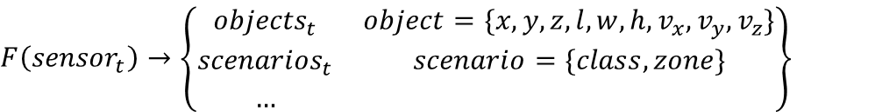
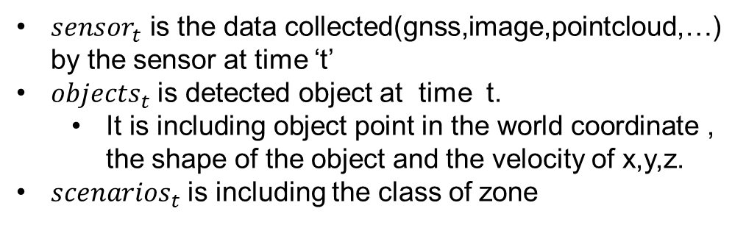
WHAT IS THE MULTISENSOR FUSION & BACKGROUND?
WHAT’S ON THE WAY?
$$F\left({sensor}_{t}\right)→\left\{\begin{matrix}{objects}_{t} & object=\{x,y,z,l,w,h,v_{x},v_{y},v_{z}\} \\ {scenarios}_{t} & scenario=\{class,zone\} \\ … & \end{matrix}\right\}$$
${sensor}_{t}$ is the data collected(gnss,image,pointcloud,…) by the sensor at time ‘t’
${objects}_{t}$ is detected object at time t.
It is including object point in the world coordinate , the shape of the object and the velocity of x,y,z.
${scenarios}_{t}$ is including the class of zone
Perception Fusion Base on
Machine
Learning
Notes:
在感知融合问题上
建立一个 所有传感器数据与 对象，场景等映射关系
其中object就是被识别出来的物体，包括了 它的坐标，大小，速度等信息
场景包括了被识别出来的 某个区域，如车道线，路沿，花坛等区域以及类型

Slide 6
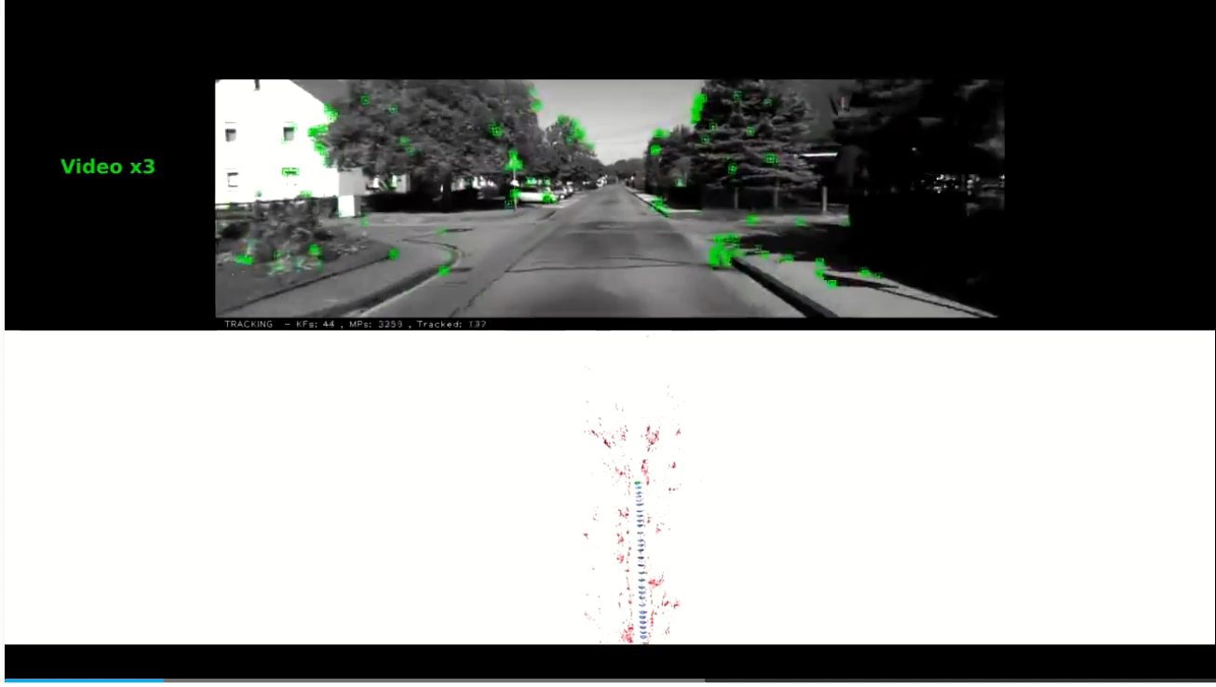
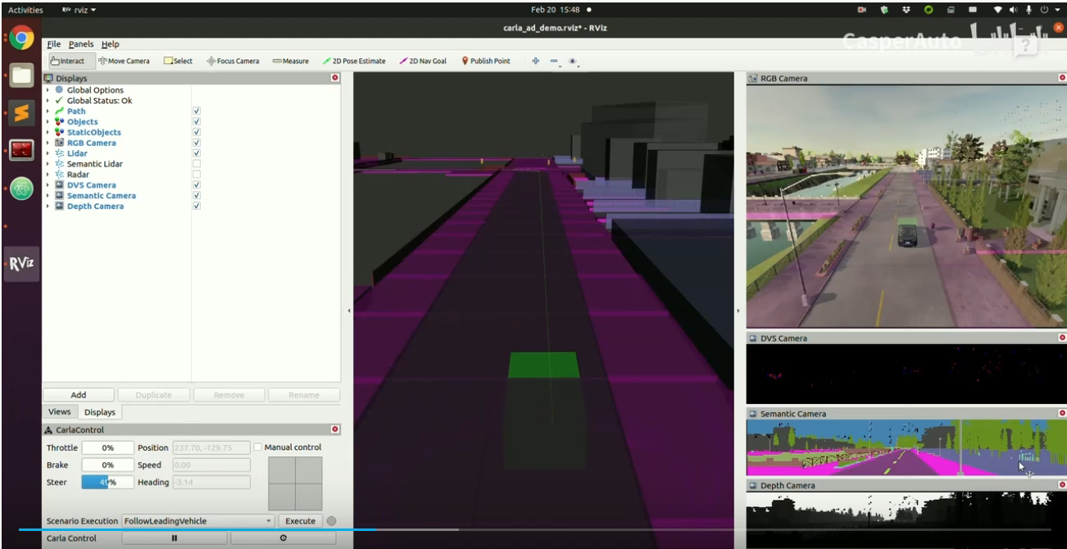
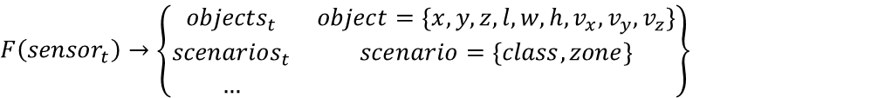
WHAT IS THE MULTISENSOR FUSION & BACKGROUND?
$$F\left({sensor}_{t}\right)→ \left\{{\left[\begin{matrix}R & t \\ 0 & 1\end{matrix}\right]}_{t},\left\{{landmarks}_{0}，{landmarks}_{1}…{landmarks}_{t}\right\}\right\}$$
$$F\left({sensor}_{t}\right)→\left\{\begin{matrix}{objects}_{t} & object=\{x,y,z,l,w,h,v_{x},v_{y},v_{z}\} \\ {scenarios}_{t} & scenario=\{class,zone\} \\ … & \end{matrix}\right\}$$
Notes:
左边的是车辆上装有2个摄像头，通过路上采集的图片信息，构建

Slide 7
Notes:
包含的内容有3个方面

Slide 8




Features – Perception Inputs Analysis
L2+/L3 Features
Coupling level start increasing
Hands- free HWA
Acceptable coupling level
TJP
All obstacle around
(for normal object/ construction cases)
All obstacle around
(for normal object/ construction cases)
Map based path [complicated ramp]
Navigation Pilot
Close object (close cut in case)
Virtual lane center
(When lane marker not good enough)
All near objects
(for dynamic biasing)
Virtual lane center
(When lane marker not good enough)
All near objects
(for dynamic biasing)
All road edges, virtual lanes
[generate possible target path in complicated ramp]
Dynamic collision relevant
Trajectory Planning relevant
Static collision relevant
Path Planning relevant
Notes:
包含的内容有3个方面

Slide 9
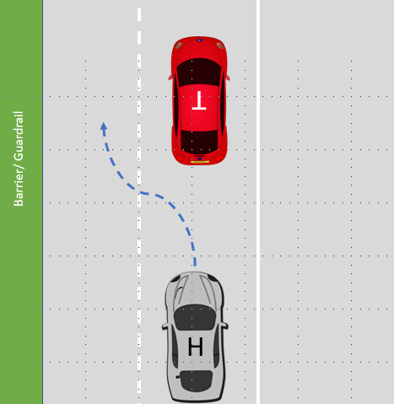
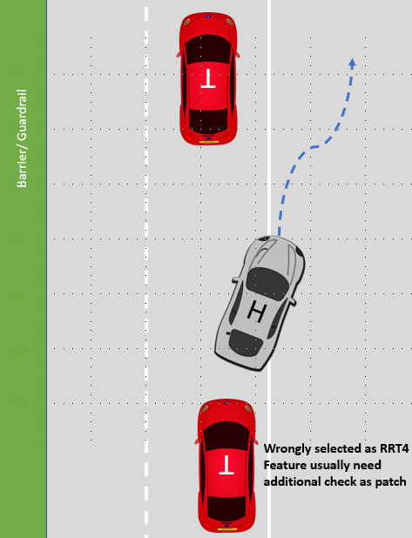
Challenge case for L2+ feature inputs
Automated Lane Change
Outer LM missing/ unclear
Need a block to dynamically provide the virtual lane center in adj. lane with following input supports:
Map data (ensure there is drivable lane)
Free space (ensure there is enough space)
Guardrail/ motion of other objects (find best driving target path)
Wrong RRT assignment during lane change
Due to the rear road model limitation, it can not be avoided on wrong target assignment, need some block to use following input to provide centralized free space information combined target dynamic properties:
Map data/ free space (ensure the probability of RRT assignment)
Notes:
包含的内容有3个方面

Slide 10
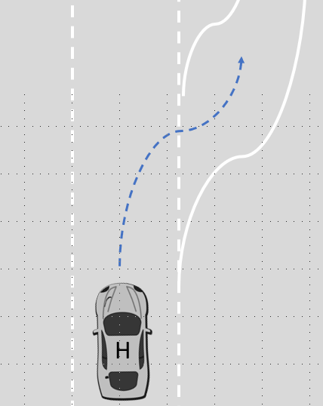
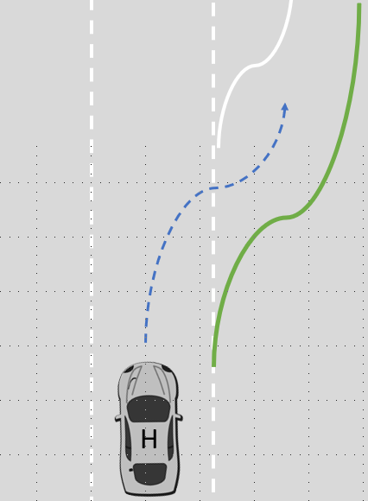
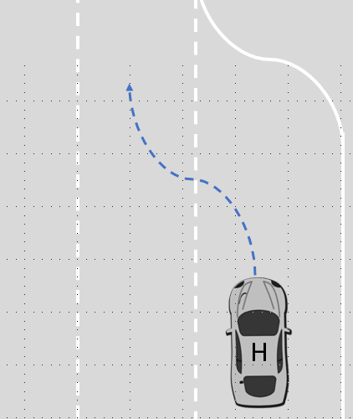
Challenge case for L2+ feature inputs
Map based ref. trj.
Major conflict is:
Current Vision based input is not enough for control => Current requiring Map based static ref. trj.
For short- window ramp out, SPP/Vision Lane can not see in adv.
For merge in, Vision Lane can not tell the end line
Feature need to separately handling the static map-based ref. trj. With following limitation:
The native ref. line quality (smooth, connectivity)
Localization quality
Mismatch between Map- Reality
Complicated Ramp with bad map/ vision conditions
Vision can not see the ramp- in end line for long. deceleration
Vision can not see the ramp- out for lateral control
Bad LM condition on right
Notes:
包含的内容有3个方面

Slide 11
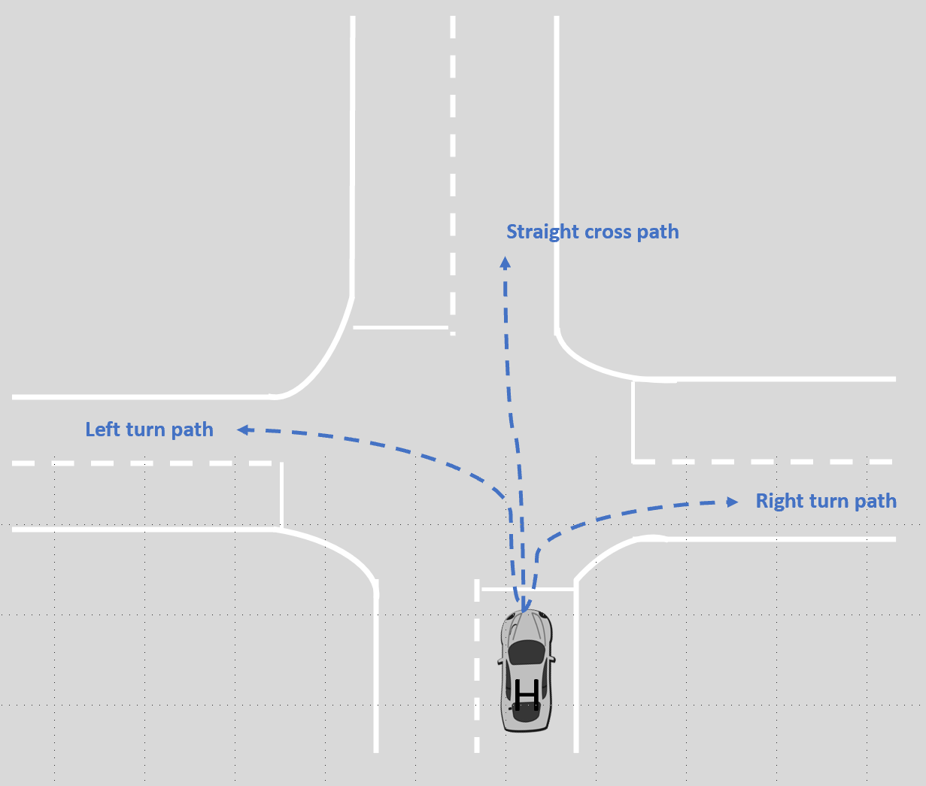
Challenge case for L3 feature inputs
Missing Guidance Path in cross traffic
Major conflict is:
Currently, pure vision input can not provide enough control path guidance in cross traffic scenario
Due to the limitation of ME representation on lane marker (for straight cross ptah only the closet lane marker is reported)
Due to the limitation of Camera FOV (left/ right turn)
The support from the HD-Map based static path is qualified as single source, due to:
Localization/ Map quality
Cross traffic
Notes:
包含的内容有3个方面

Slide 12
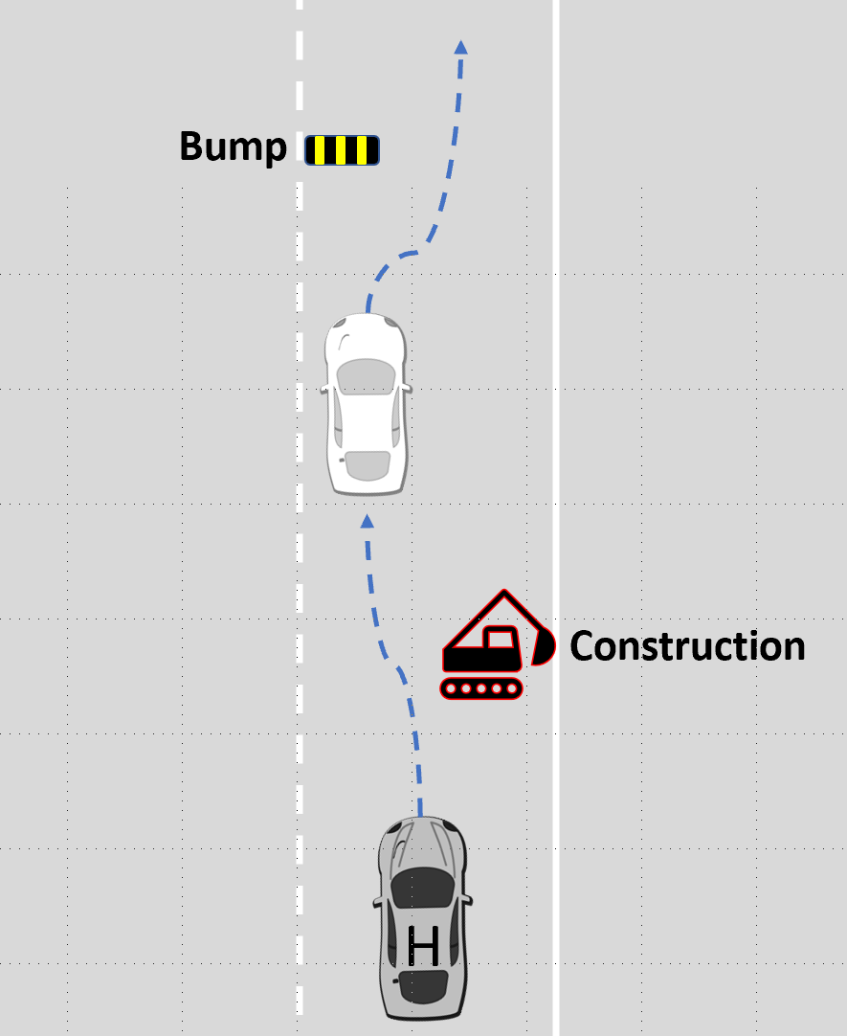
Challenge case for L3 feature inputs
Incorrect guidance Path for obstacles [Incl. into ODD since L3]
Major conflict is:
Currently, pure vision- based guidance can not provide the biasing support, due to
ME can not detect the general object/ free space info
Input from Map is not accurate enough for control
Even when adding vision/ radar/ lidar free space, feature will face the complicated input source with extremely high computation power
Lane Biasing for obstacles
Notes:
包含的内容有3个方面

Slide 13
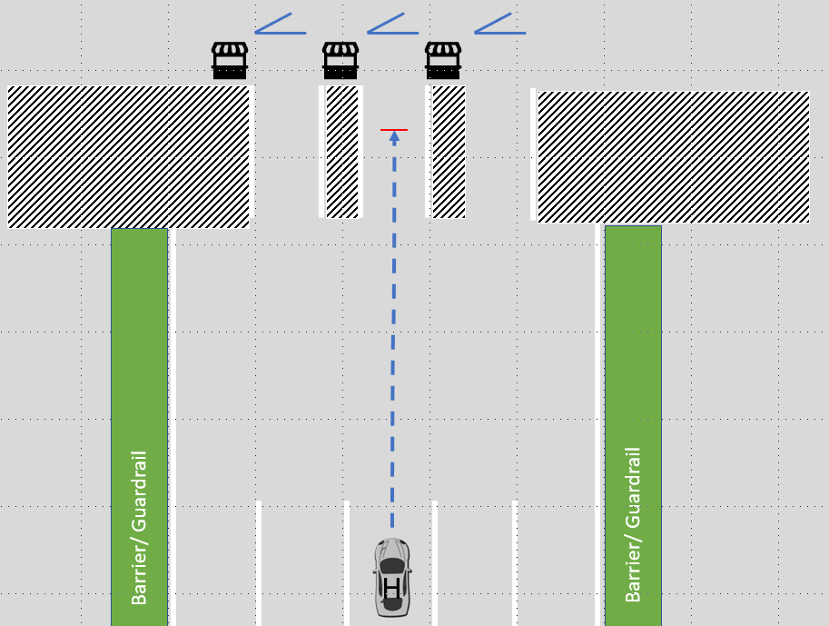
Challenge case for L3 feature inputs
Incorrect guidance Path for obstacles [Incl. into ODD since L3]
Major conflict is:
Lane marker is not always available in order to generate guidance path for vehicle control
Current no valid input can be used in “stop& go” scenario before the toll gate
With simple Map data is not enough for vehicle control, due to:
Localization Quality
The environment in toll area always change very often, which might not suit the description compared to Map source
Toll pass
Notes:
包含的内容有3个方面

Slide 14

Centralized Middle Layer – Environmental Model
Sensor Source
Perception
Vision Perception
LM/ RE as low-level function trigger conditions
EM
Radar Tracker
Fusion
Objects/ Barriers
Centralized lateral control guidance Path
Features
Lidar Tracker
Lidar obstacles
Centralized Free Corridor Information
Map
[v2/ v3]
EHR
Map reference
V2X
V2X objects/ Infrastructures Info
SATA
AEB/ ACC Targets
Notes:
包含的内容有3个方面

Slide 15
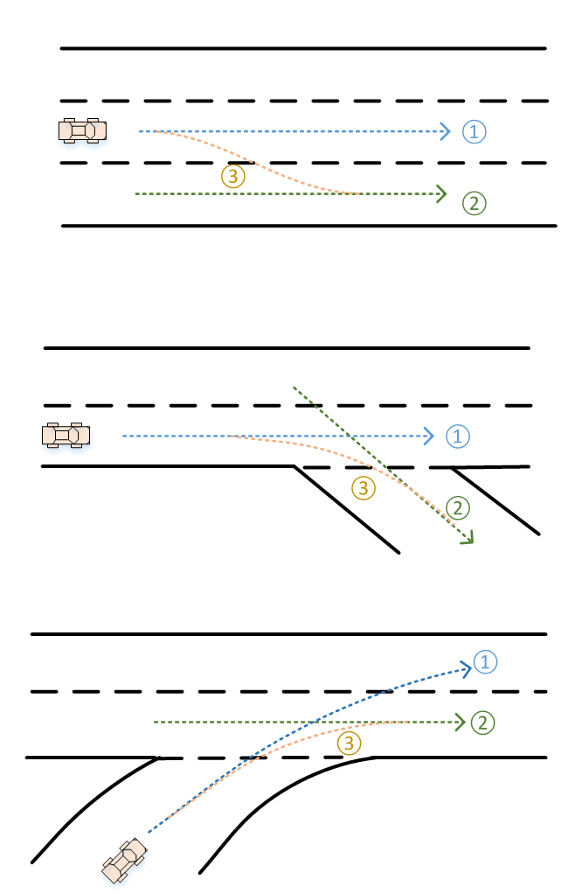
Lateral Control Guidance Path
Key Point
Static based reference path
Input for trj. Planning from feature
Static reference as target for trj. Planning
Feature can dynamically adapt the vehicle trajectory according to risk represented by free corridor and vehicle dynamic/ comfort limitations
Multiple reference path input for feature as choice
Host Lane guidance
Guidance to keep host in lane center
Dynamic adaption according to current feature status (LKA/ ELK or LCK)
Target Lane guidance
Guidance for the target lane/ path
According to the planning information [Lane change, ramp in/ out by NOP]
Lane Change guidance [opt. for feature usage]
Guidance for the lane change/ ramp in-out case
Like “connection path” between host and target lane path
Take line type/ corridor into consideration
Planned interface overview
5th order polynomial with start/end point(?)
VCS based with constant update rate
Fusion source (vision LM/ vision free space/ radar free space/ Map/ Lidar etc.)
Confidence level
Notes:
包含的内容有3个方面

Slide 16
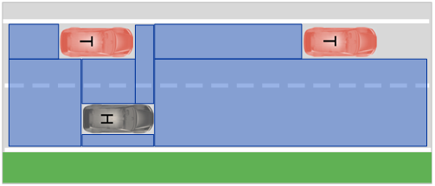
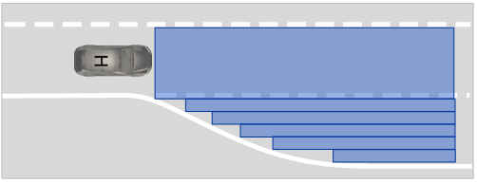
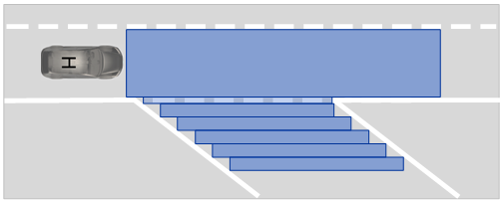
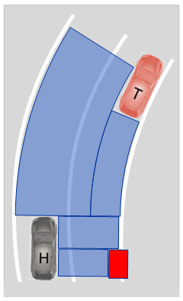
Collision free corridor
Key Point
Static + dynamic based free corridor
Static information from vision/radar free space, Map, vision road edge, radar guardrail
Dynamic information from fusion objects
Both forwards, backwards and side corridor
Rich information on corridor boundary
Edge of corridor with both static and dynamic properties:
Range, Range Rate, Acceleration, source
Easy using& Cost saving
Fernet coordinate
Dynamic size of corridor, combined corridors with similar properties
Notes:
包含的内容有3个方面

Slide 17
Collision free corridor – Opt. 2 Fence based
Key Point
Static + dynamic based free corridor
Static information from vision/radar free space, Map, vision road edge, radar guardrail
Dynamic information from fusion objects
Both forwards, backwards and side corridor
Rich information on corridor boundary
Edge of corridor with both static and dynamic properties:
Range, Range Rate, Acceleration, source
Easy using& Cost saving
Fernet coordinate
Dynamic size of corridor, combined corridors with similar properties
Notes:
包含的内容有3个方面

Slide 18








Proposed Project Tooling
Matlab script
C in ROS
Algo. Dev.
Integration Environment
Re-simulation
MATLAB Coder
Build ENV
PC on Car
C- based replay
Baisc Vis.
Notes:
包含的内容有3个方面

Slide 19
Proposed Project Timing
E2XX release
Add new supported inputs:
Radar free space
Lidar free space (if avail.)
E1XX release
LC guidance with current input for following scenarios:
LKA/LCK
Ramp
Free corridor with existing inputs
Mar.
Sept.
Jun.
Dec.
Kick off
Get ROS/ C framework done (Comm./ Replay) in end Apr.
E2XX release
LC guidance with vision free space for scenarios:
Obstacle in lane
Free corridor with new inputs:
Vision free space
Notes:
包含的内容有3个方面

Slide 20
Additional needed HW
Inputs | Relevant HW | Comments
HDMAP | Map box | Reuse the one on HHT
Vision free space | ADCAM- MID | Need debug version of ADCAM which can output vision free space
Radar free space | SRR6+ and CarPC | Cooperate with radar ML team
Lidar free space | ? | ?
V2X | Alps V2X module | Already avail.
Notes:
包含的内容有3个方面

